Slide 1
521157A – Introduction to Social Network Seminar
Crime Network Analysis
Giuseppe Superbo
Nicola Zotto
Xiaowen Wang

Slide 2
Background
The analysis relies on a unique dataset from operation Oversize, an Italian criminal case against a mafia group.
Investigation periods: 2000 – 2006
Targeted suspects: > 50
Crime: international drug trafficking, homicides and robberies
Trial periods: 2007 – 2009
Judgement results:
-the main suspects were convicted with penalties from 5 to 22 years of imprisonment
-Most suspects were affiliated to the ‘Ndrangheta’, a mafia from Calabria (a southern Italian region) with ramifications in other regions and abroad.

Slide 3
Dataset
(Oversize Network: https://figshare.com/articles/Oversize_network/3156067)
The zip file contains three networks (adjacency matrices -- binary unweighted -- in CSV format) describing the criminal organization targeted by operation Oversize (2000-2009), an Italian criminal case against a mafia group.
netWR.csv: Wiretap Records
netAW.csv: Arrest Warrant
netJU.csv: Judgement
Tools
Python 3.7
Networkx 2.0
Github: https://github.com/SuperboGiuseppe/analysis_crime_network

Slide 4

An edge between two nodes is established whenever there is at least one telephone call between the two individuals.

Slide 5
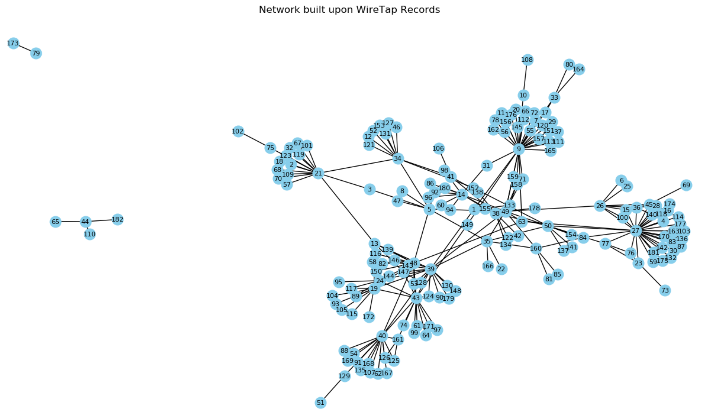
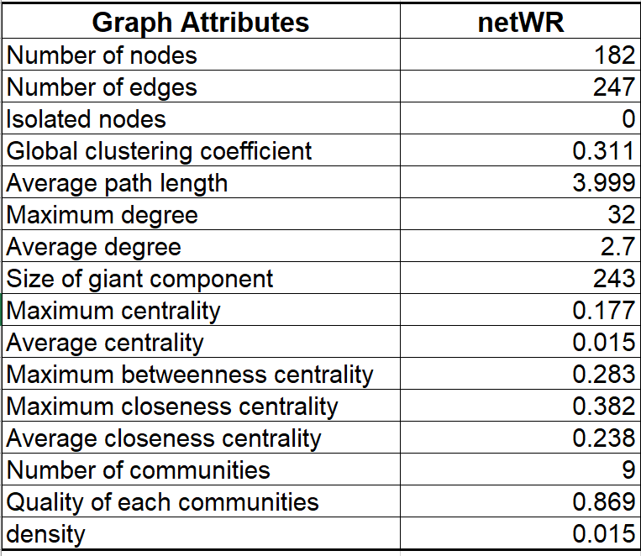
netWR - Original

Slide 6

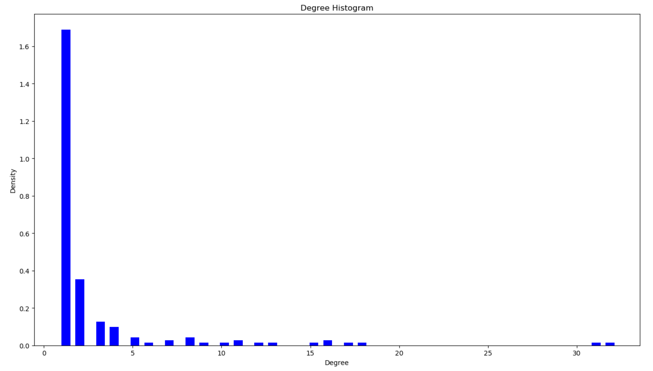
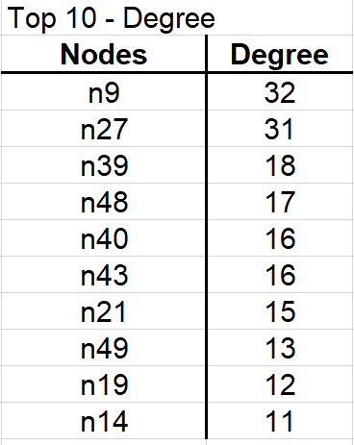
Importance of network members
Indicator 1 - Degree
Mean = 2.71
Max = 32
stDev = 4.42

Slide 7

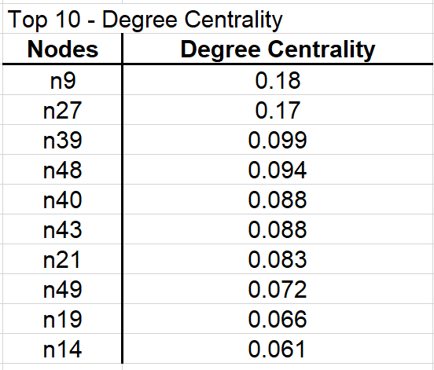
Count how many neighbours a node has.
Indicator 2 – Degree Centrality
Mean = 0.015
Max = 0.18
stDev = 0.024

Slide 8
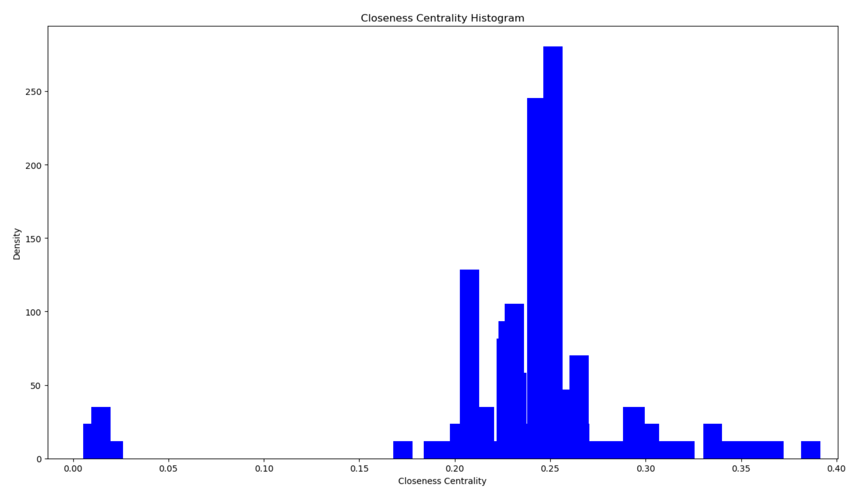
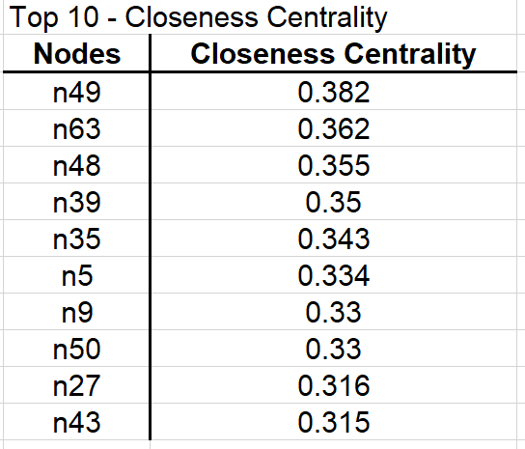
Indicator 3 – Closeness Centrality
How isloated members are?
Mean = 0.24
Max = 0.38
stDev = 0.054

Slide 9
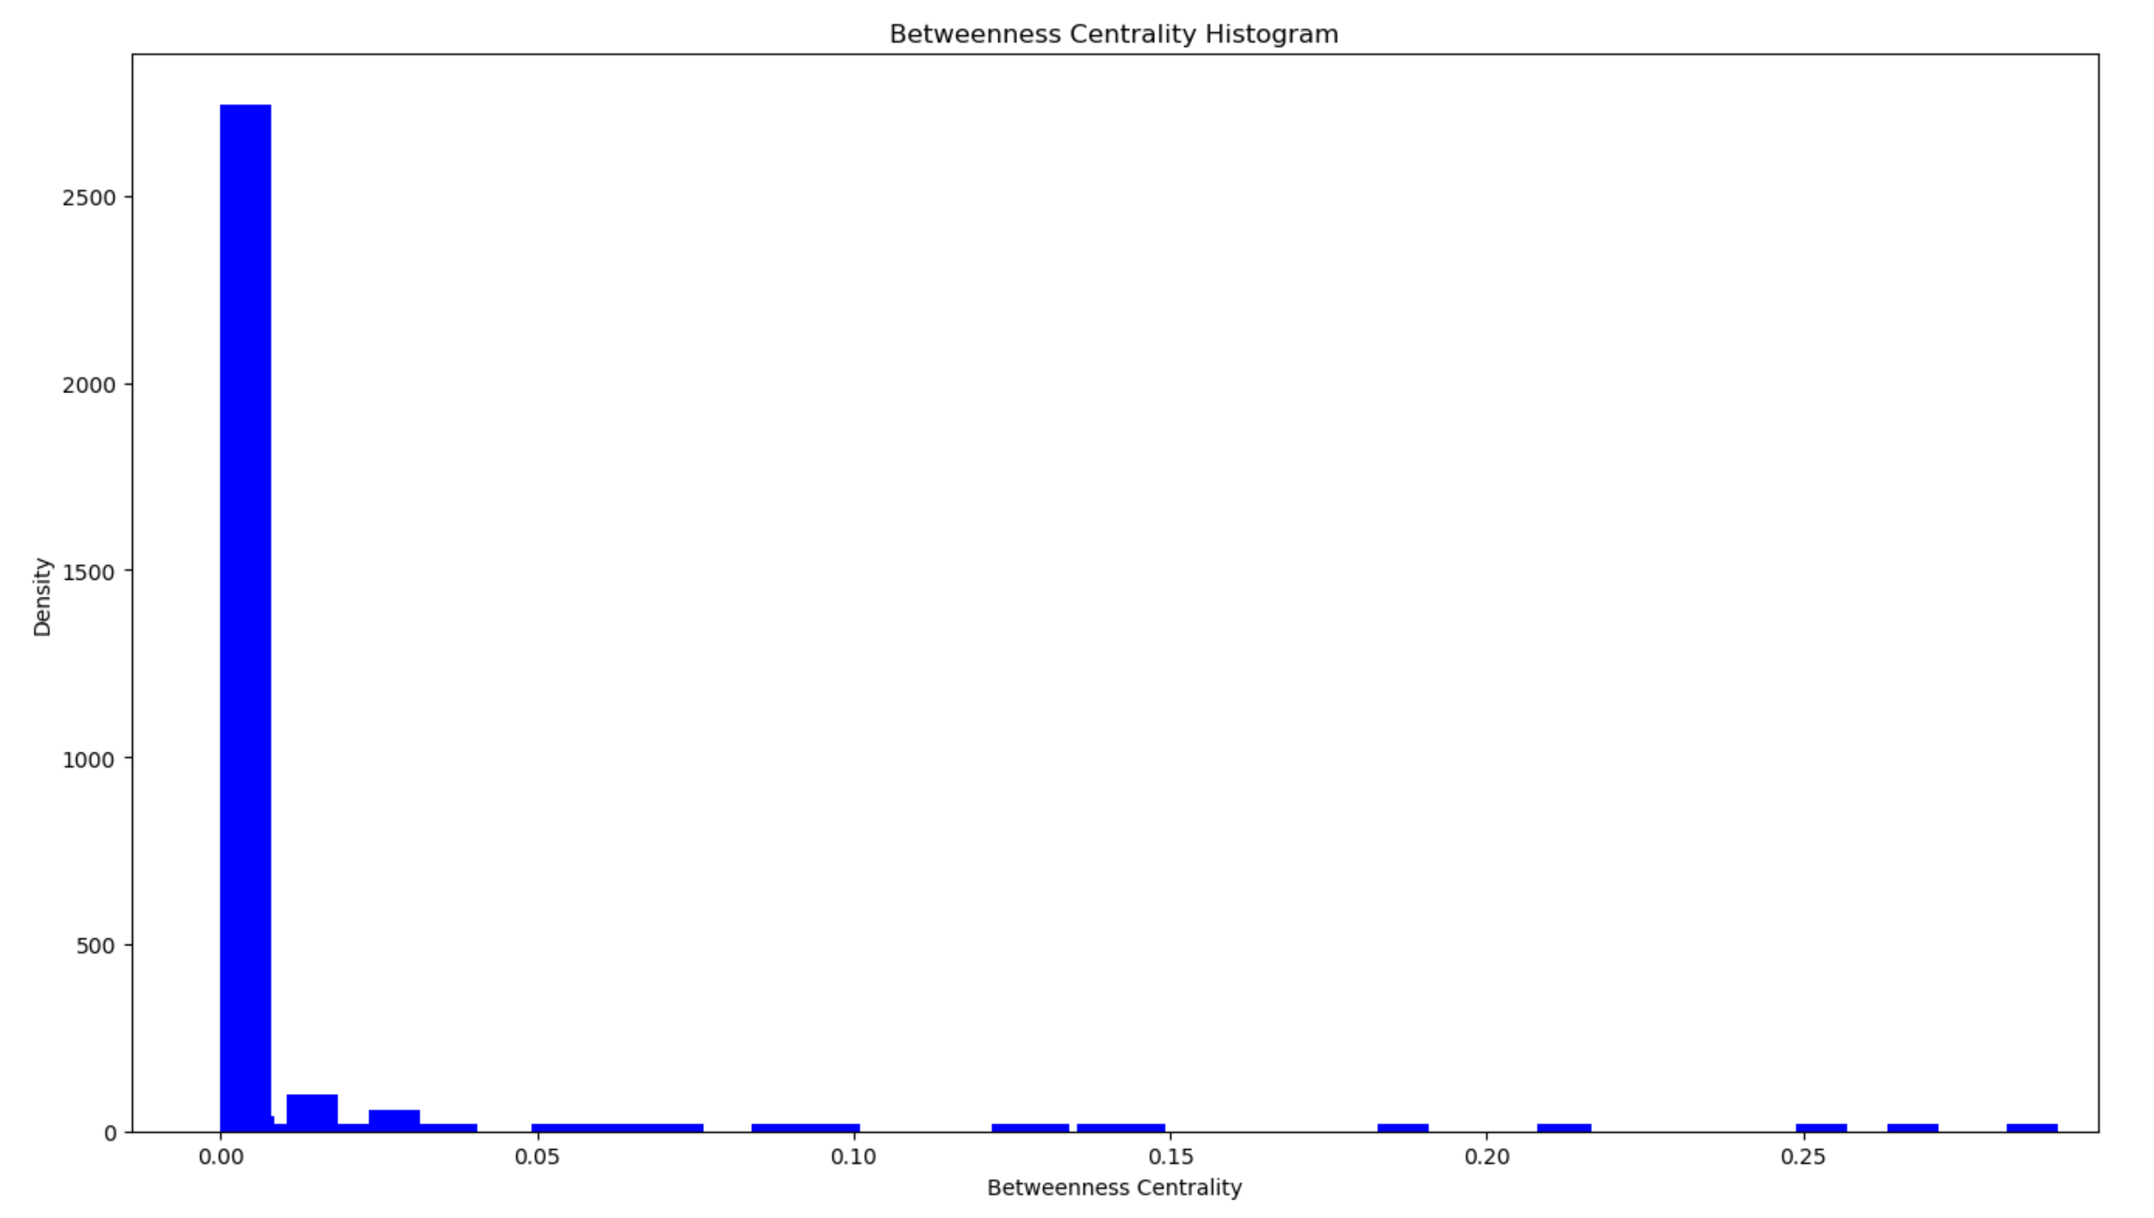
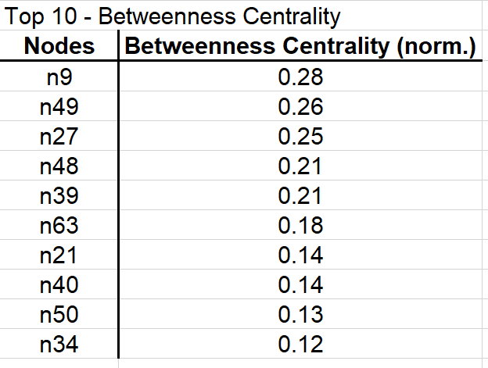
Measure the member’s capacity to act like a bridge between clusters of members!
Indicator 4 – Betweenness Centrality
Mean = 0.016
Max = 0.28
stDev = 0.048

Slide 10
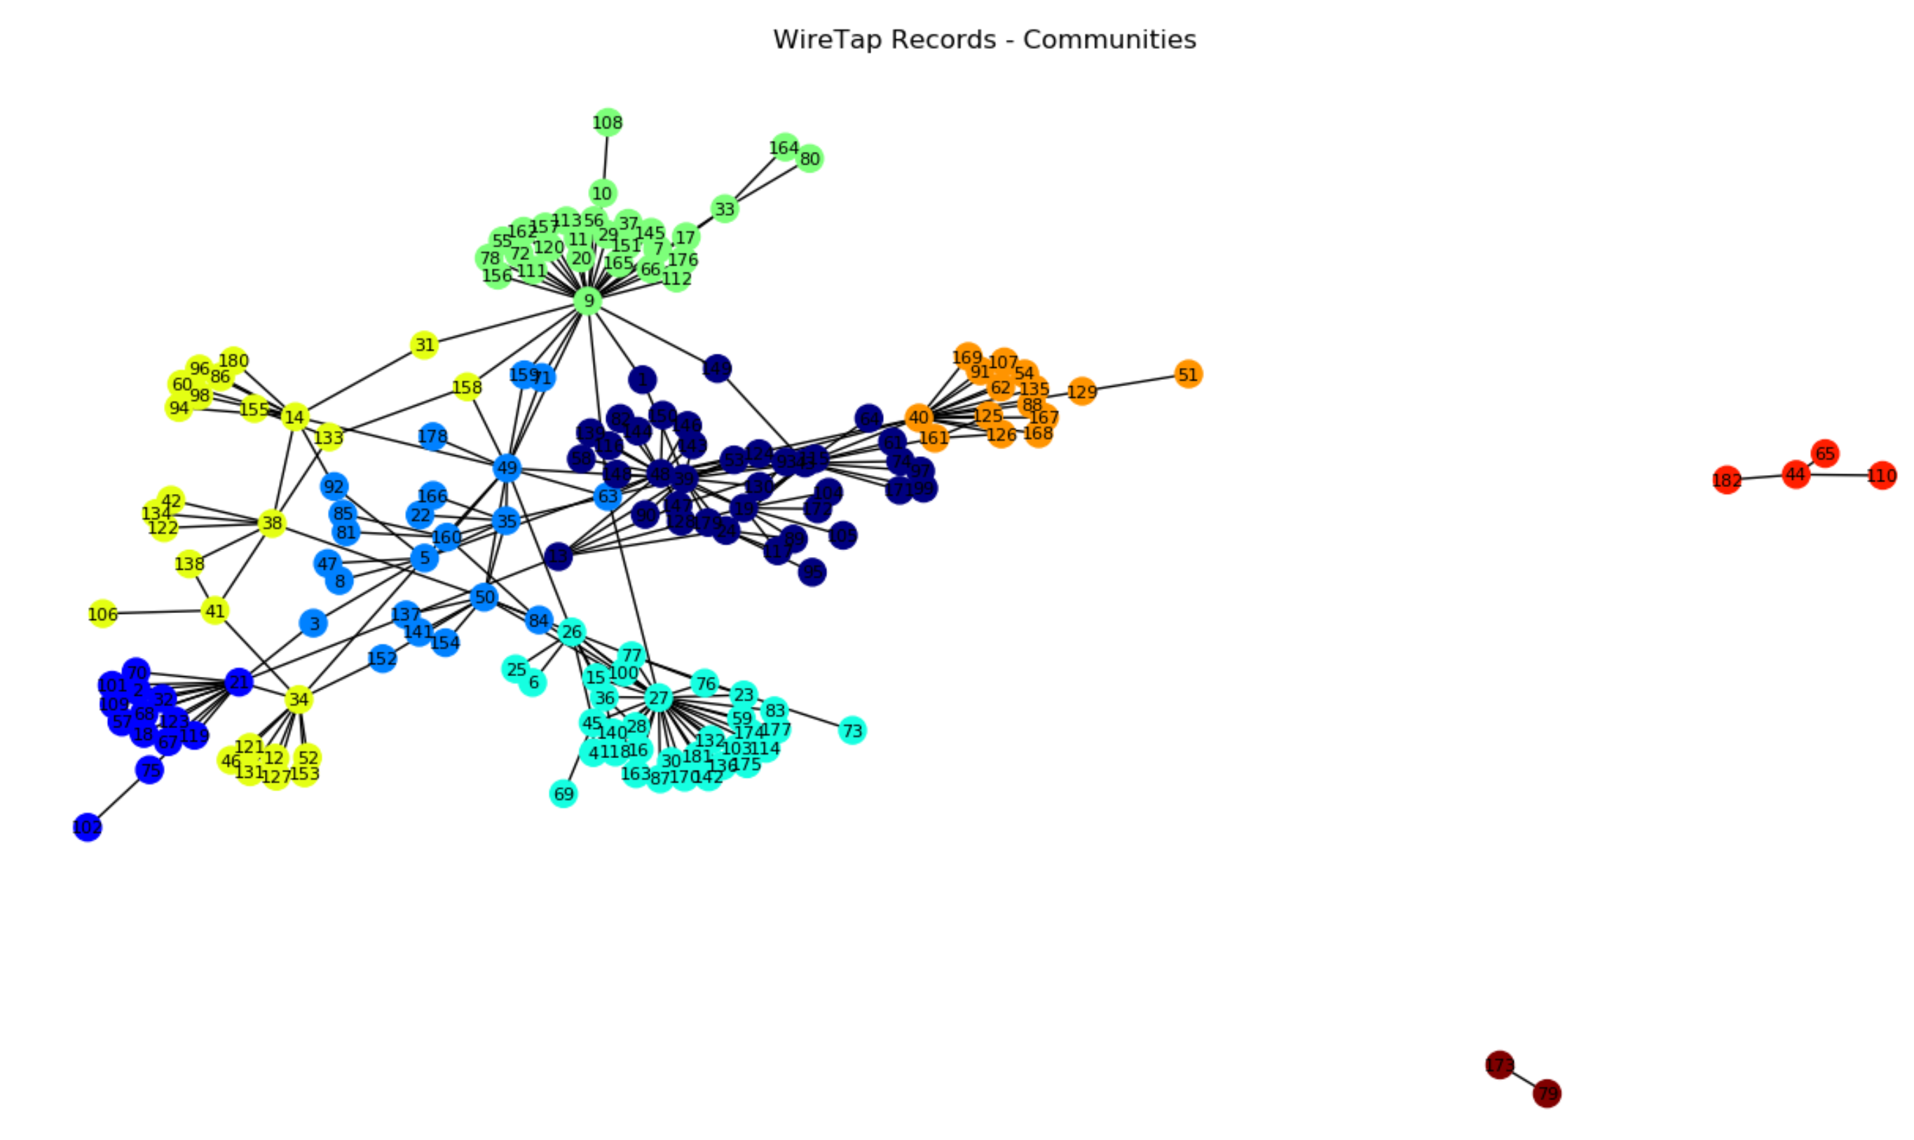
Communities Detection
Algorithm – Louvain algorithm
Communities - 9

Slide 11
What We Got…important nodes!
Top 5:
N9
N27
N49
N48
N39

Slide 12
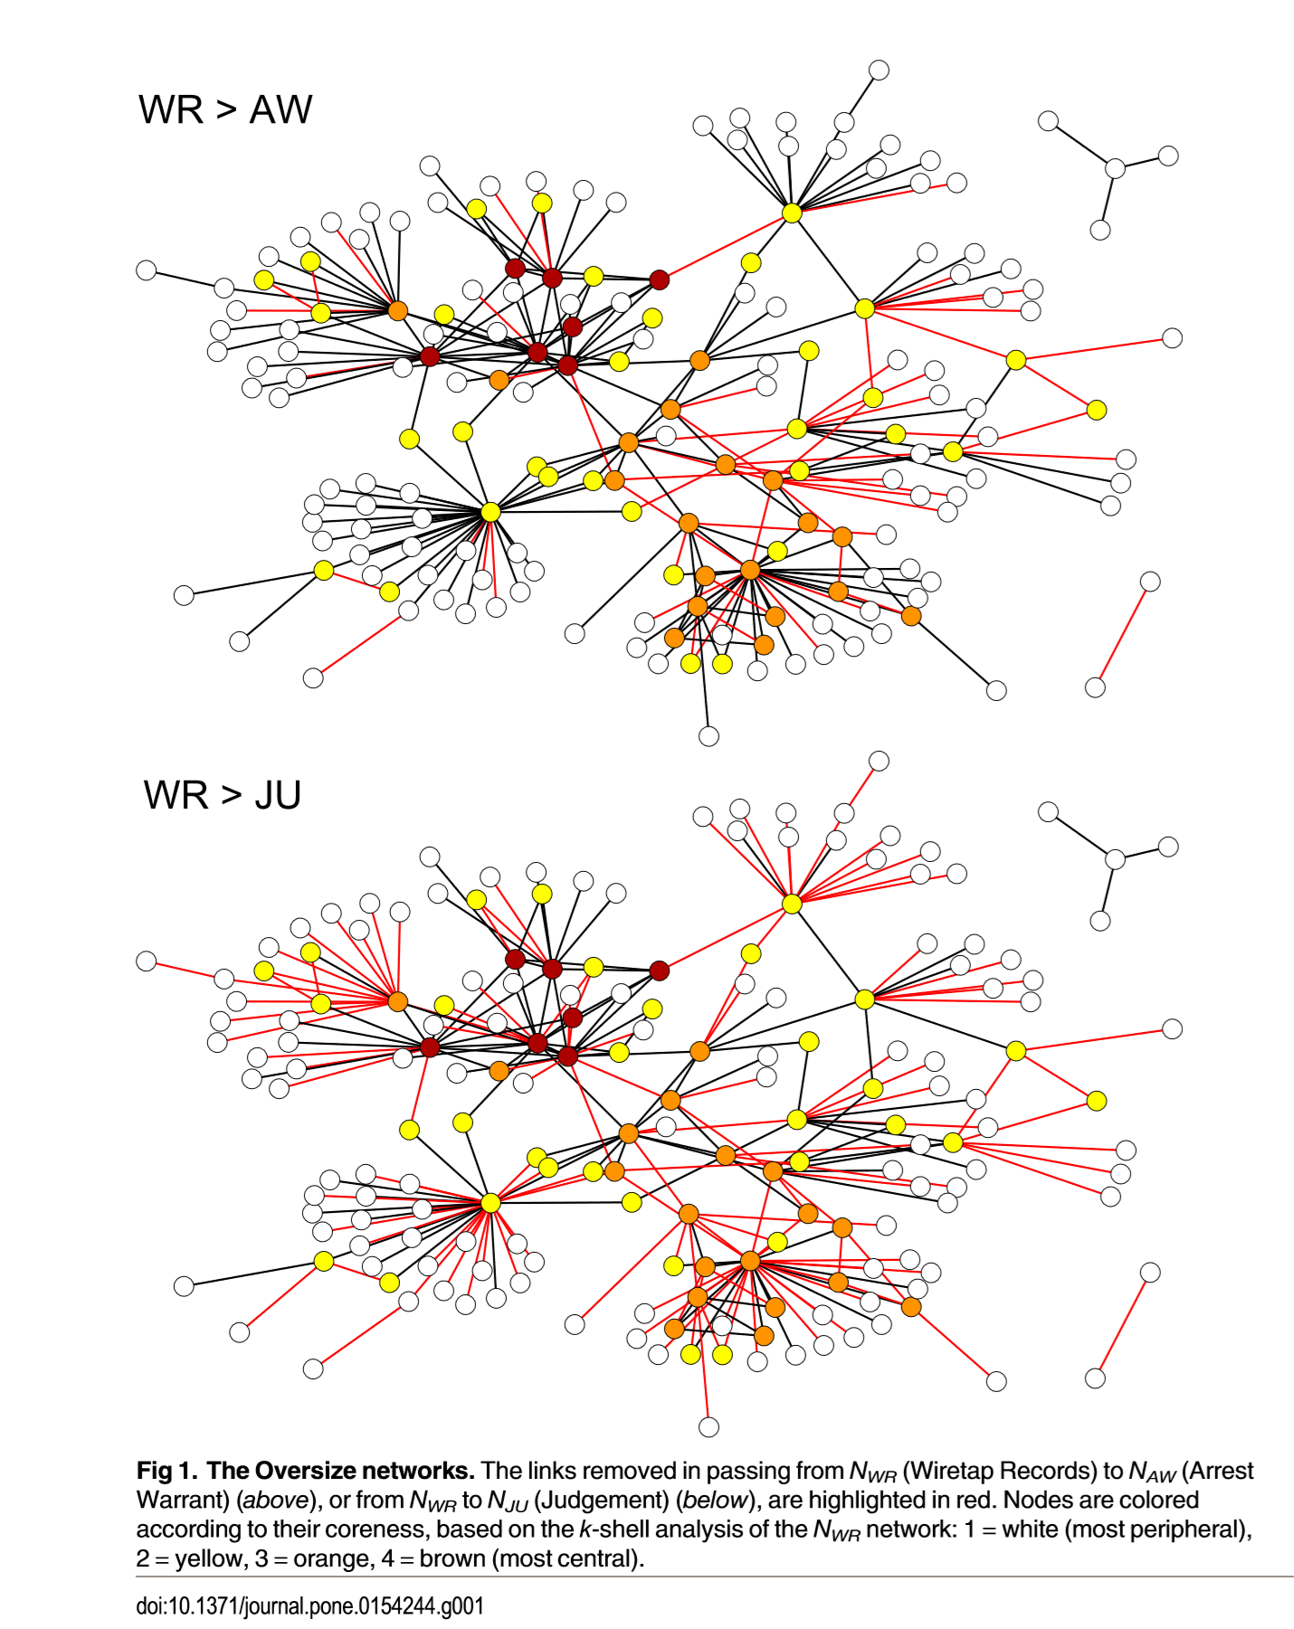

Slide 13
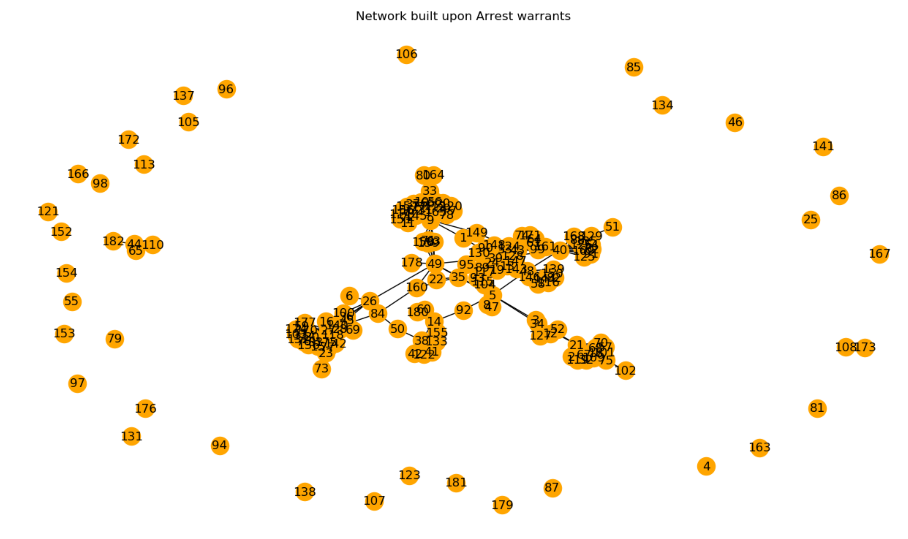
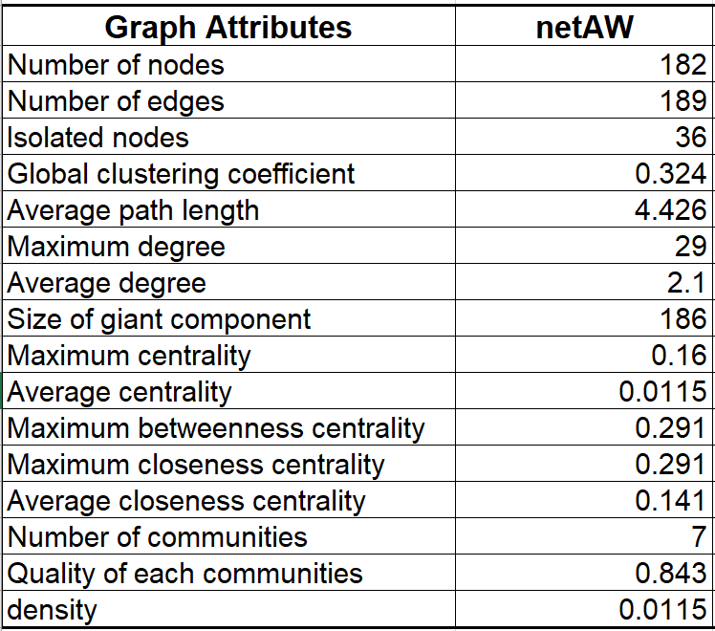
netAW - Original
From netWR:
58 edges were removed to create 36 isolated nodes.

Slide 14
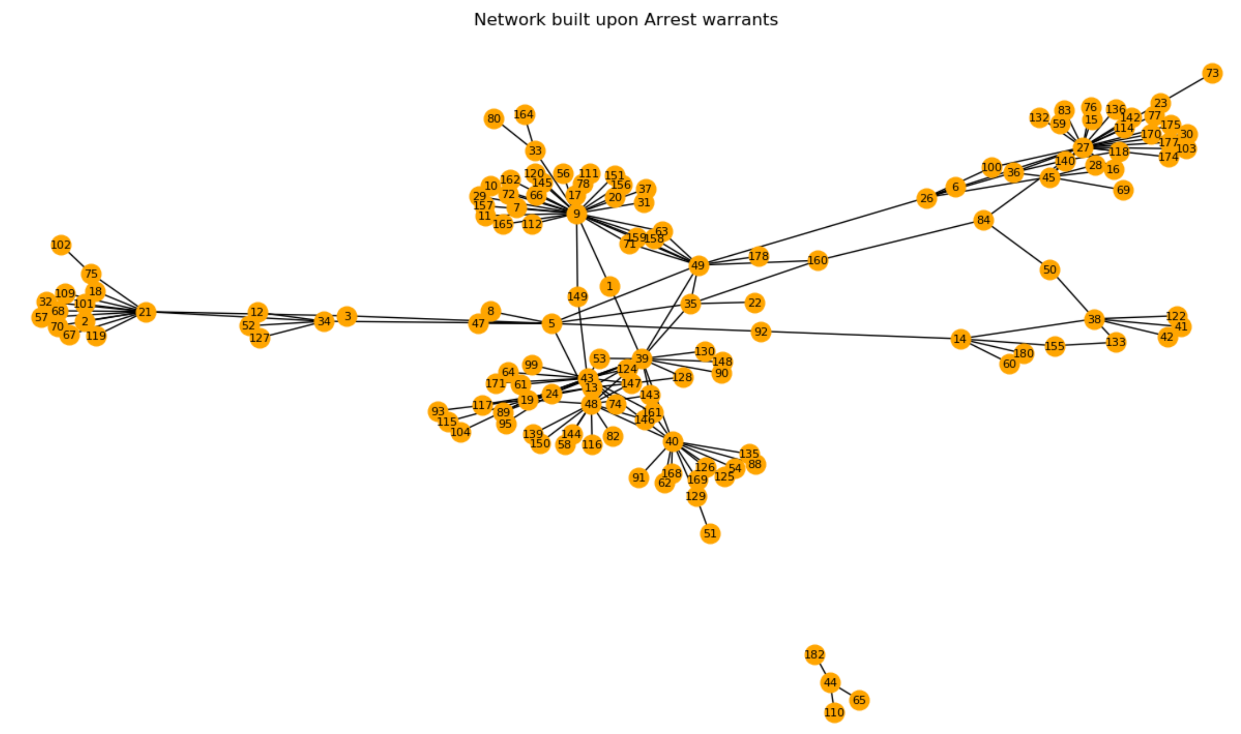
netAW - Isolated nodes removed

Slide 15
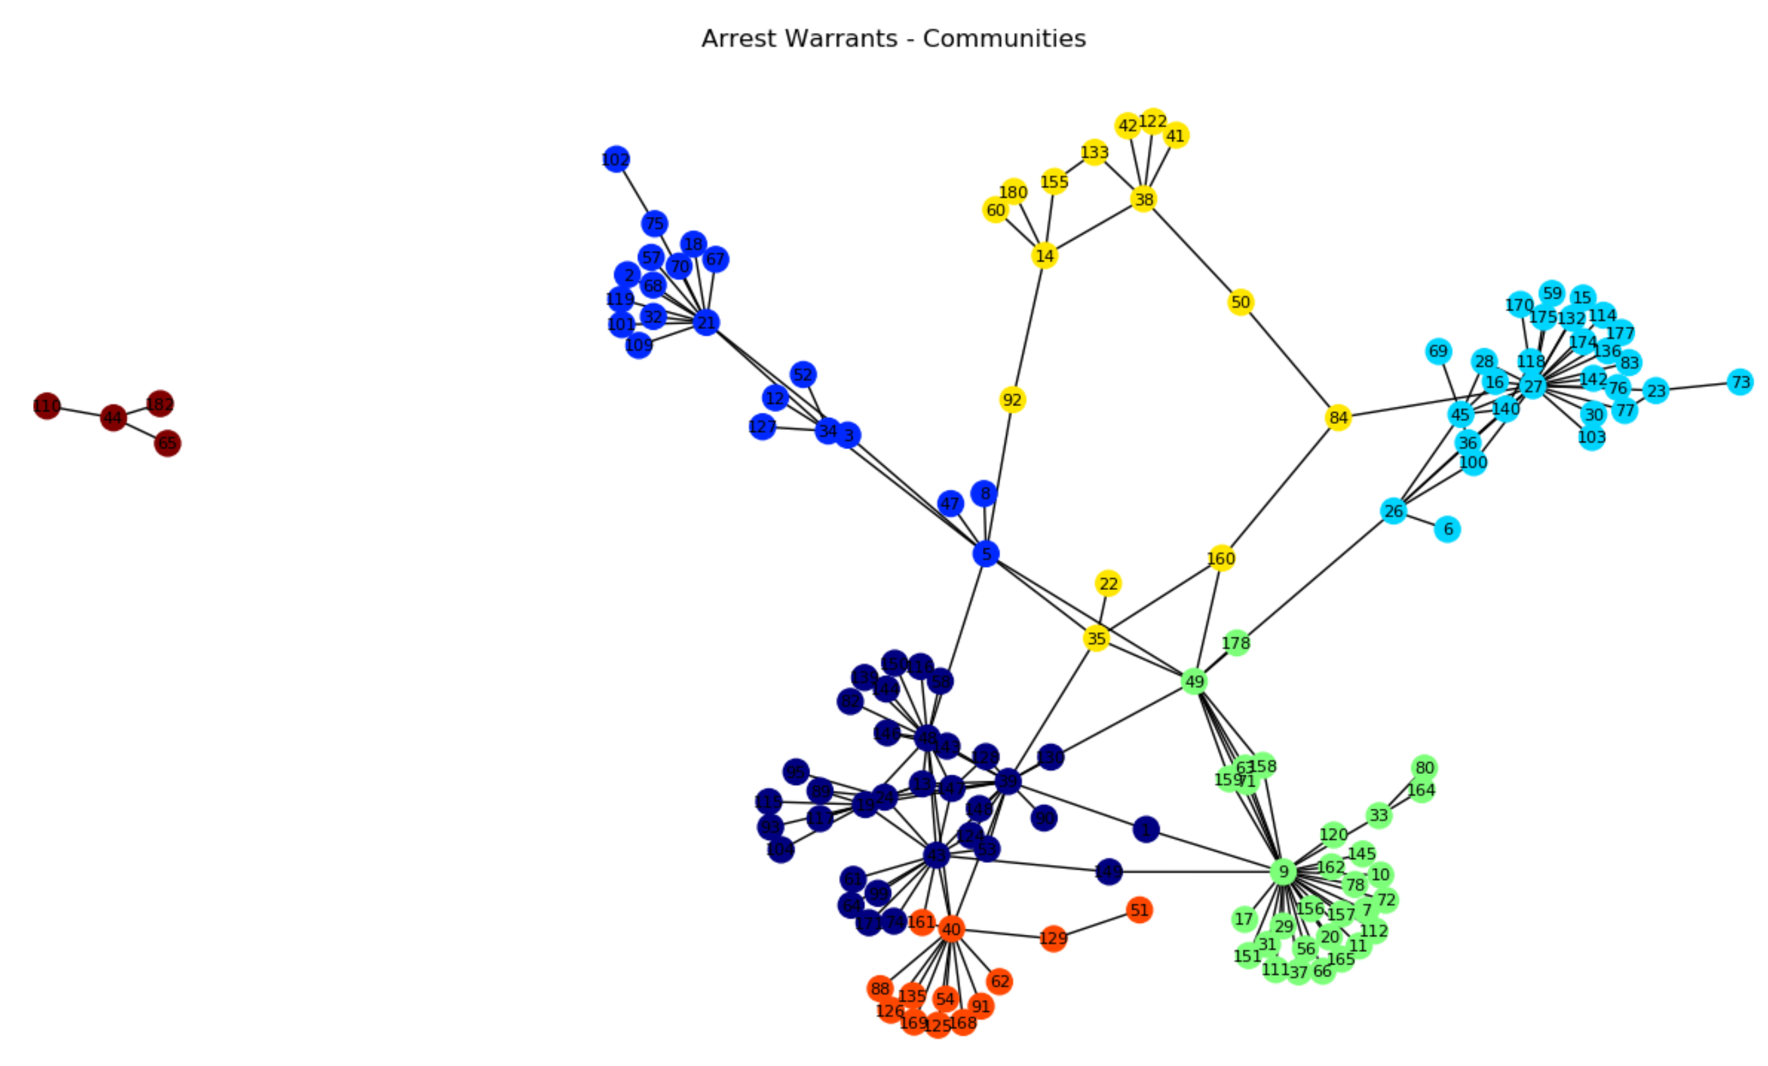
Communities Detection
Algorithm – Louvain algorithm
Communities - 7

Slide 16
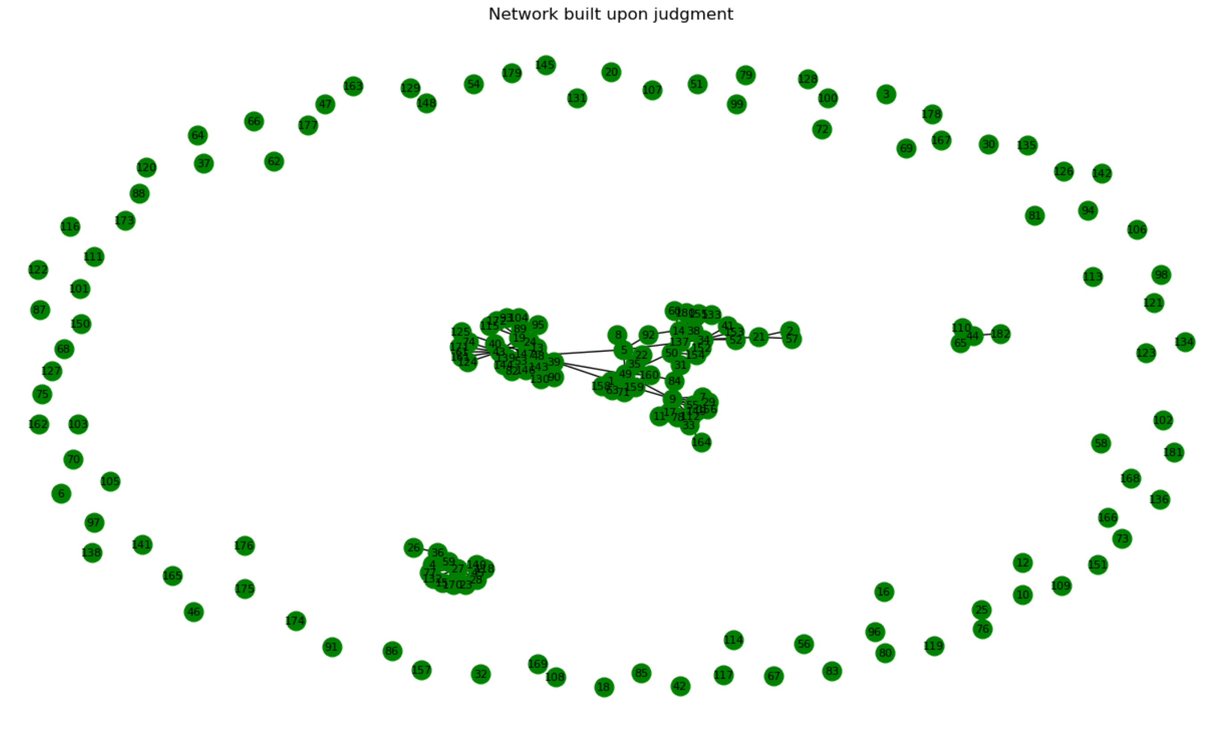
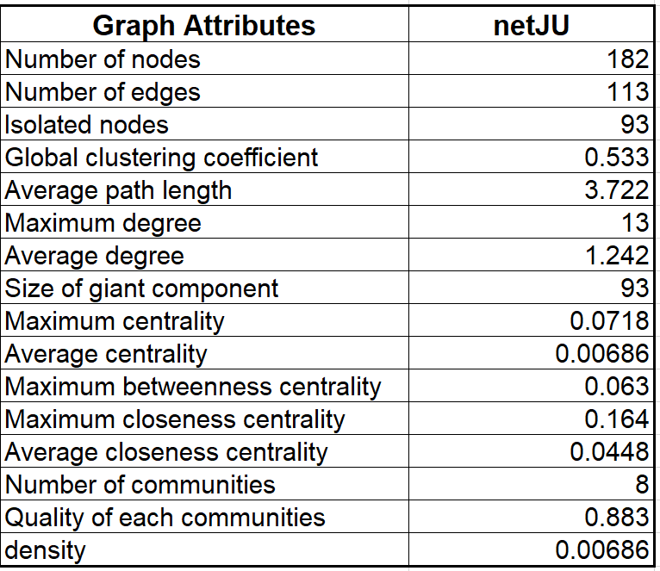
netJU - Original
From netWR:
134 edges were removed to create 93 isolated nodes.

Slide 17
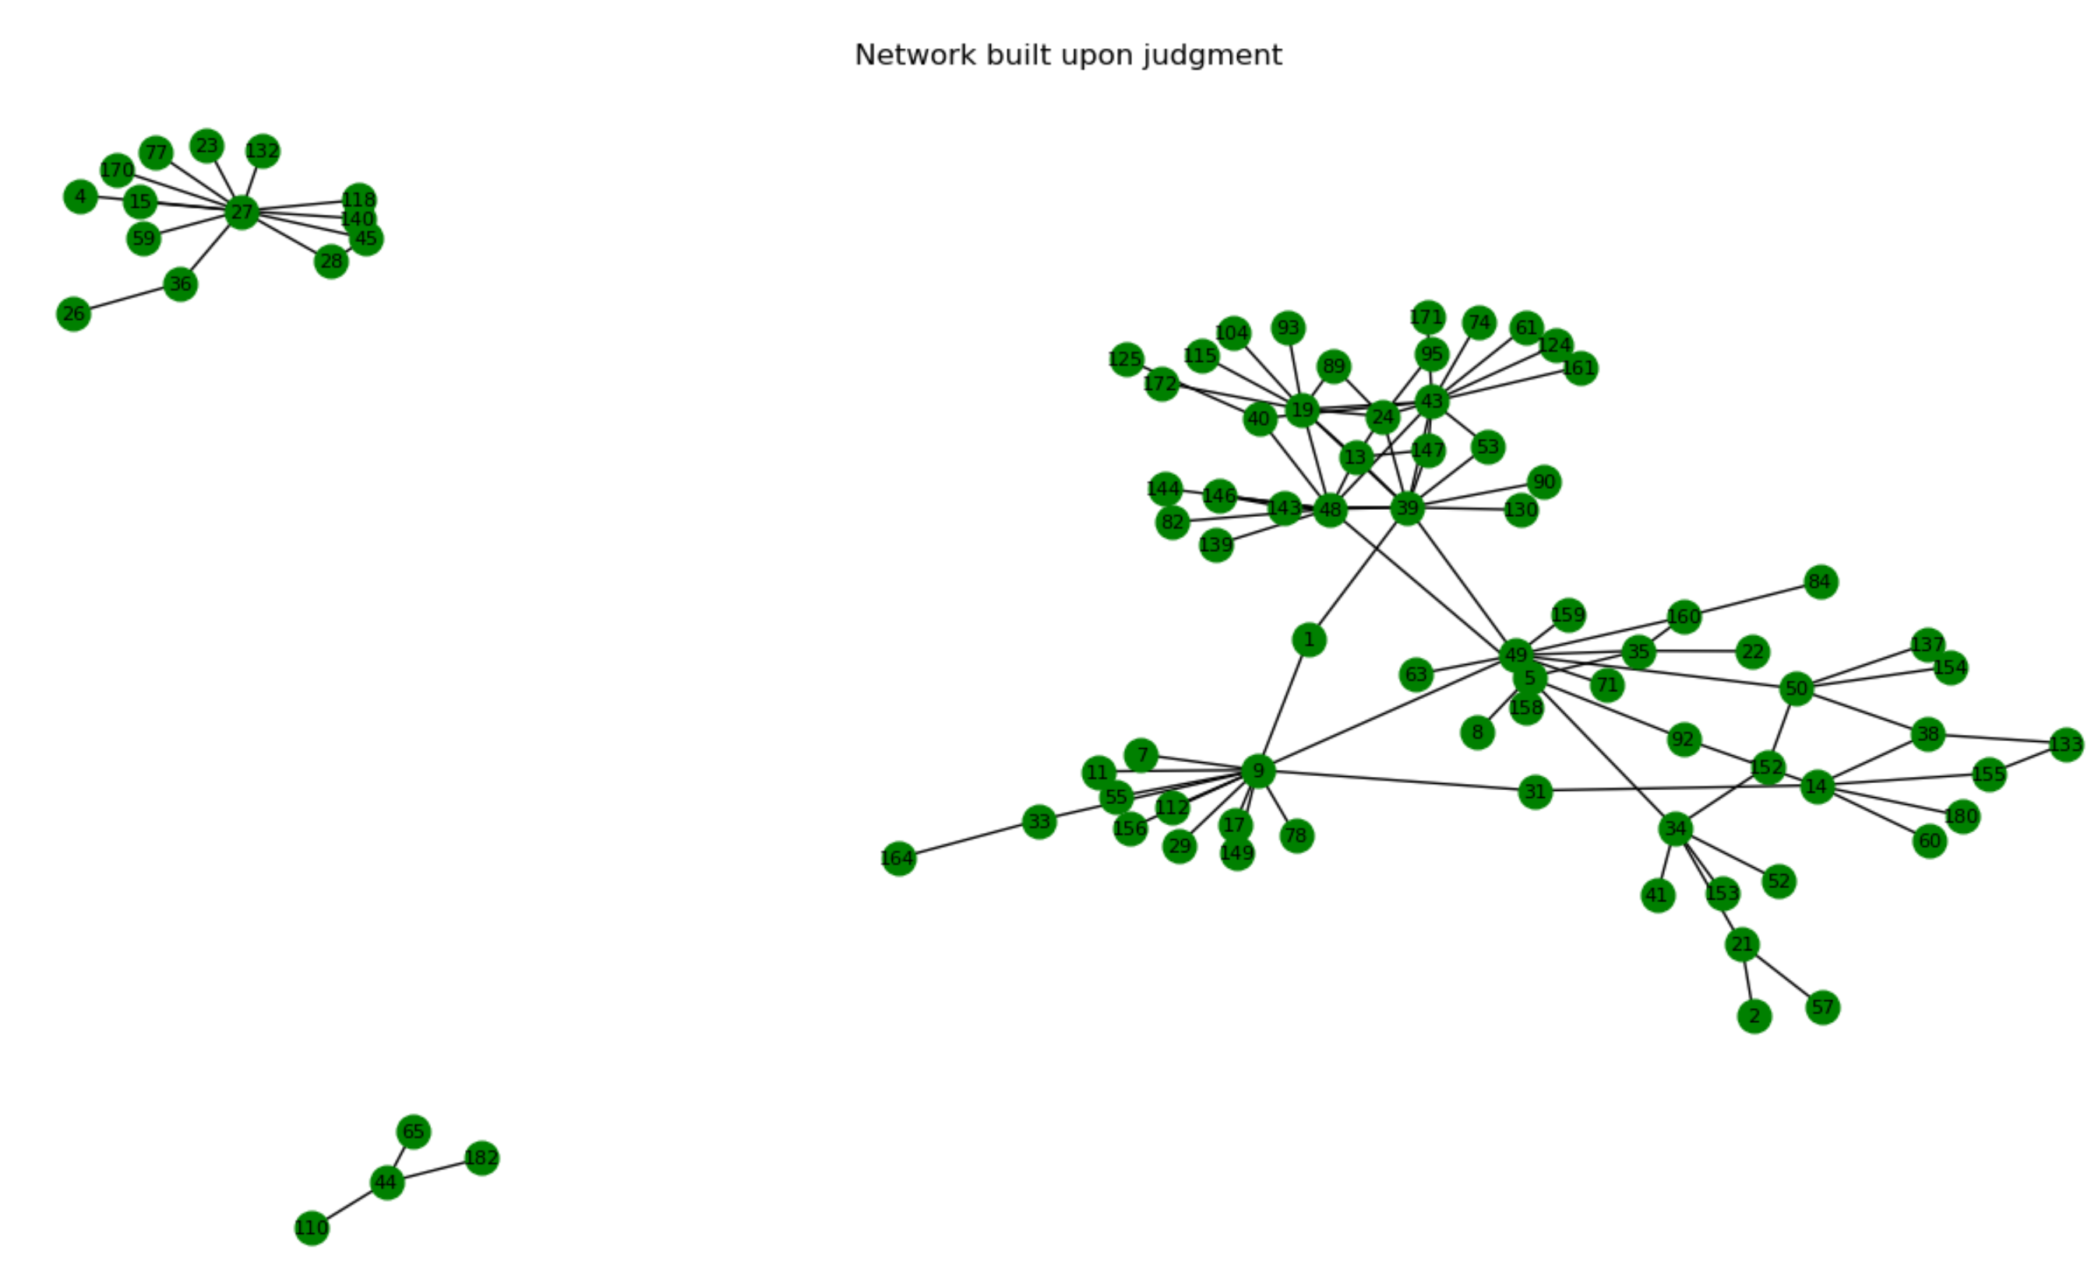
netJU - Isolated nodes removed

Slide 18
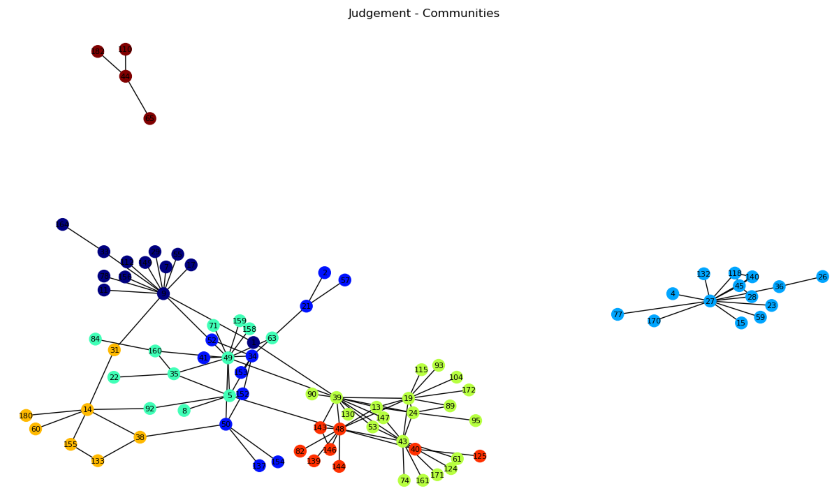
Communities Detection
Algorithm – Louvain algorithm
Communities - 8

Slide 19
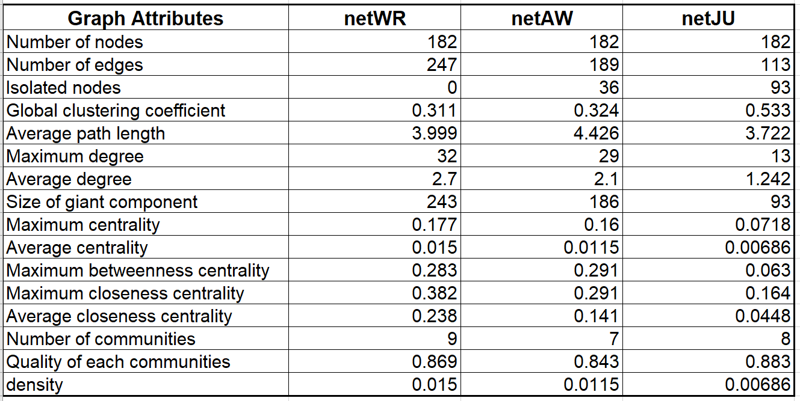
Summary
Graph attributes of three networks

Slide 20
"An edge between two nodes is established only if the number of phone calls between the two nodes is beyond a threshold k."
We created a 'Random Weighted Graph Generator' that generates a graph with weights between 1 and 40 from an adjacency matrix.
Draw plots showing the evolution with respect to k of:
The global clustering coefficient
The difference between maximum centrality and average centrality
The difference between maximum betweenness centrality and average betweenness centrality
The number of communities detected
The quality of the detected communities

Slide 21
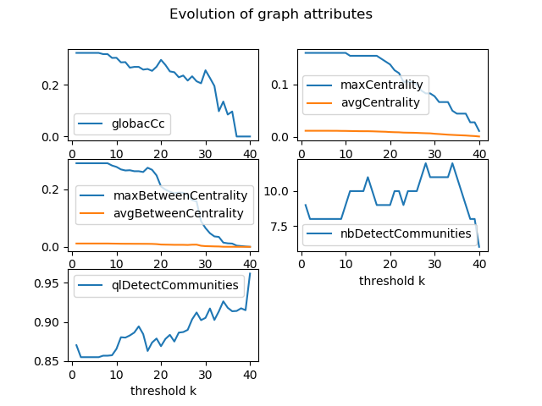
"W​iretap Records" graph

Slide 22
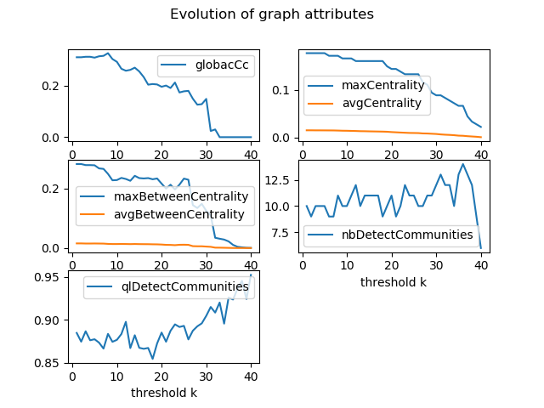
"Arrest Warrant" graph

Slide 23
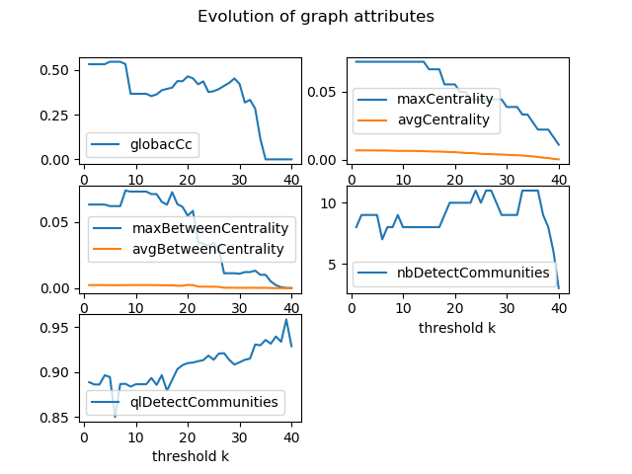
"Judgement" graph

Slide 24
We would like to investigate the consistency between the three networks as a way to construct a new edge allocation mechanism.
We assume that there is an edge between nodes A and B if the number of calls between A and B has shown important change between two Networks. As important change we thought that average weight can give a lot information about the behaviour between the nodes as weight in the network represents how many calls are instatiated between any two nodes.

Slide 25
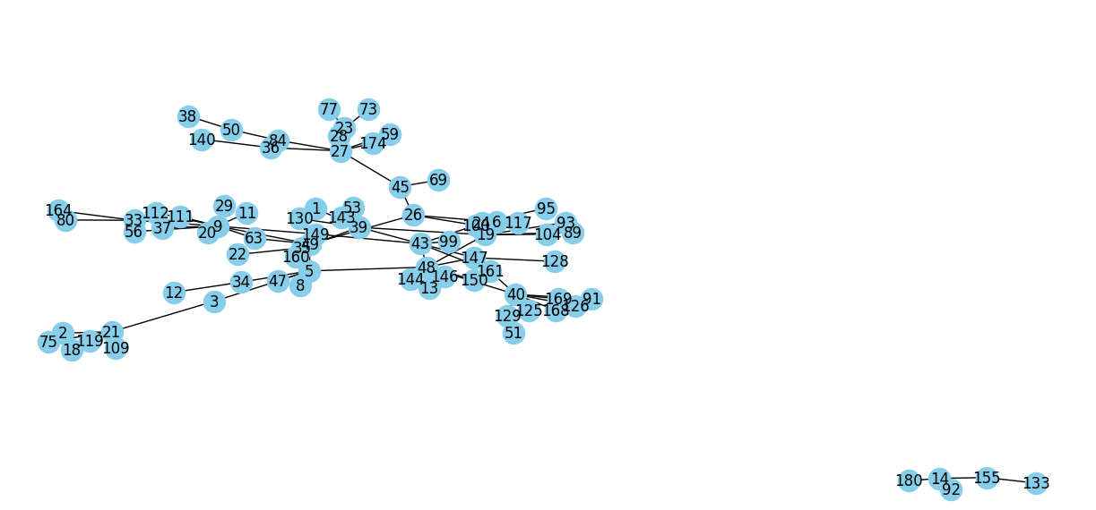
netWR < ------------ >netAW

Slide 26
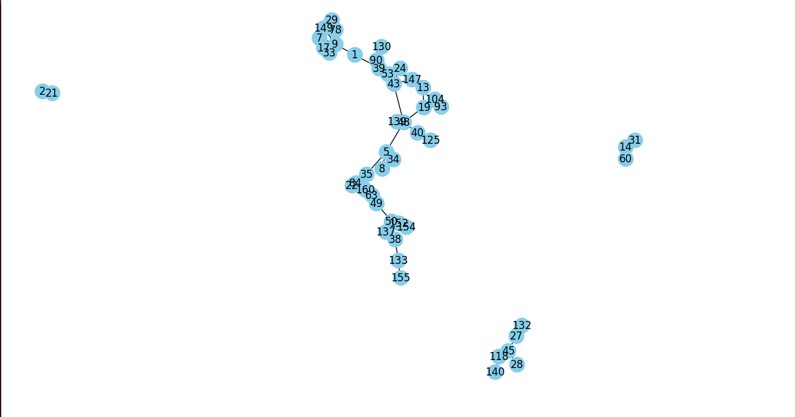
netWR < ------------ >netJU

Slide 27
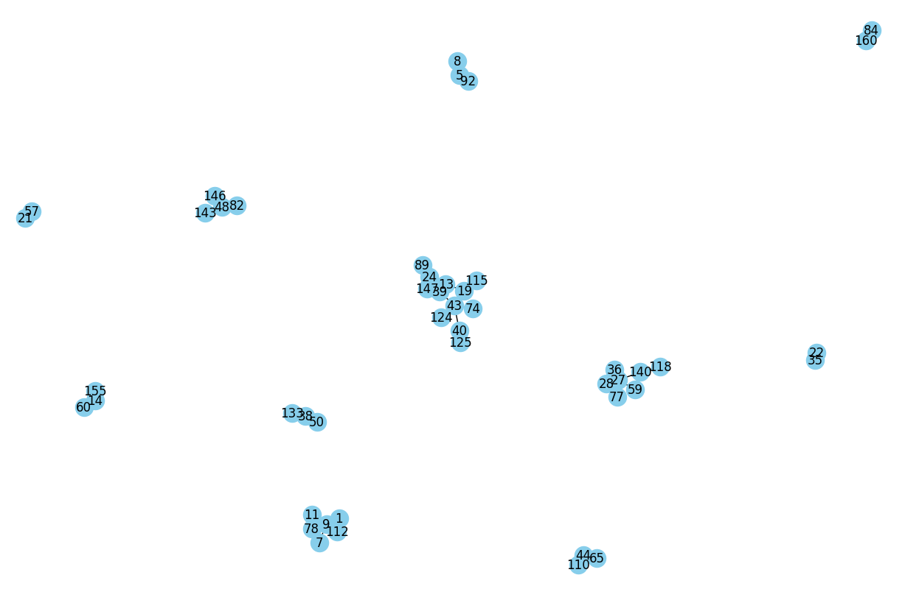
netAW < ------------ >netJU

Slide 28
Attributes | Net WR → Net AW | Net WR → Net JU | Net AW → Net JU
Number of nodes | 83 | 54 | 51
Number of edges | 87 | 50 | 41
Global clustering coef. | 0,066 | 0,097 | 0,176
Maximum degree | 9 | 9 | 9
Average degree | 2,09 | 1,85 | 1,60
Size of giant component | 82 | 40 | 13
Average path length | 4,91 | 5,34 | 2,5
Maximum centrality | 0,1341 | 0,034 | 0,1
Average centrality | 0,0255 | 0,0349 | 0,0321
Maximum betweenness centrality | 0,4351 | 0,3287 | 0,02938
Maximum closeness centrality | 0,2995 | 0,2048 | 0,134
Average closeness centrality | 0,178 | 0,1099 | 0,054
Net Density | 0,0255 | 0,034 | 0,0321
Numbers of communities | 10 | 11 | 13

Slide 29
We would like to simulate a random network whose clustering coefficient, diameter, maximum density, average density are as close as possible to that obtained in question 1 for each of the three networks.

Slide 30
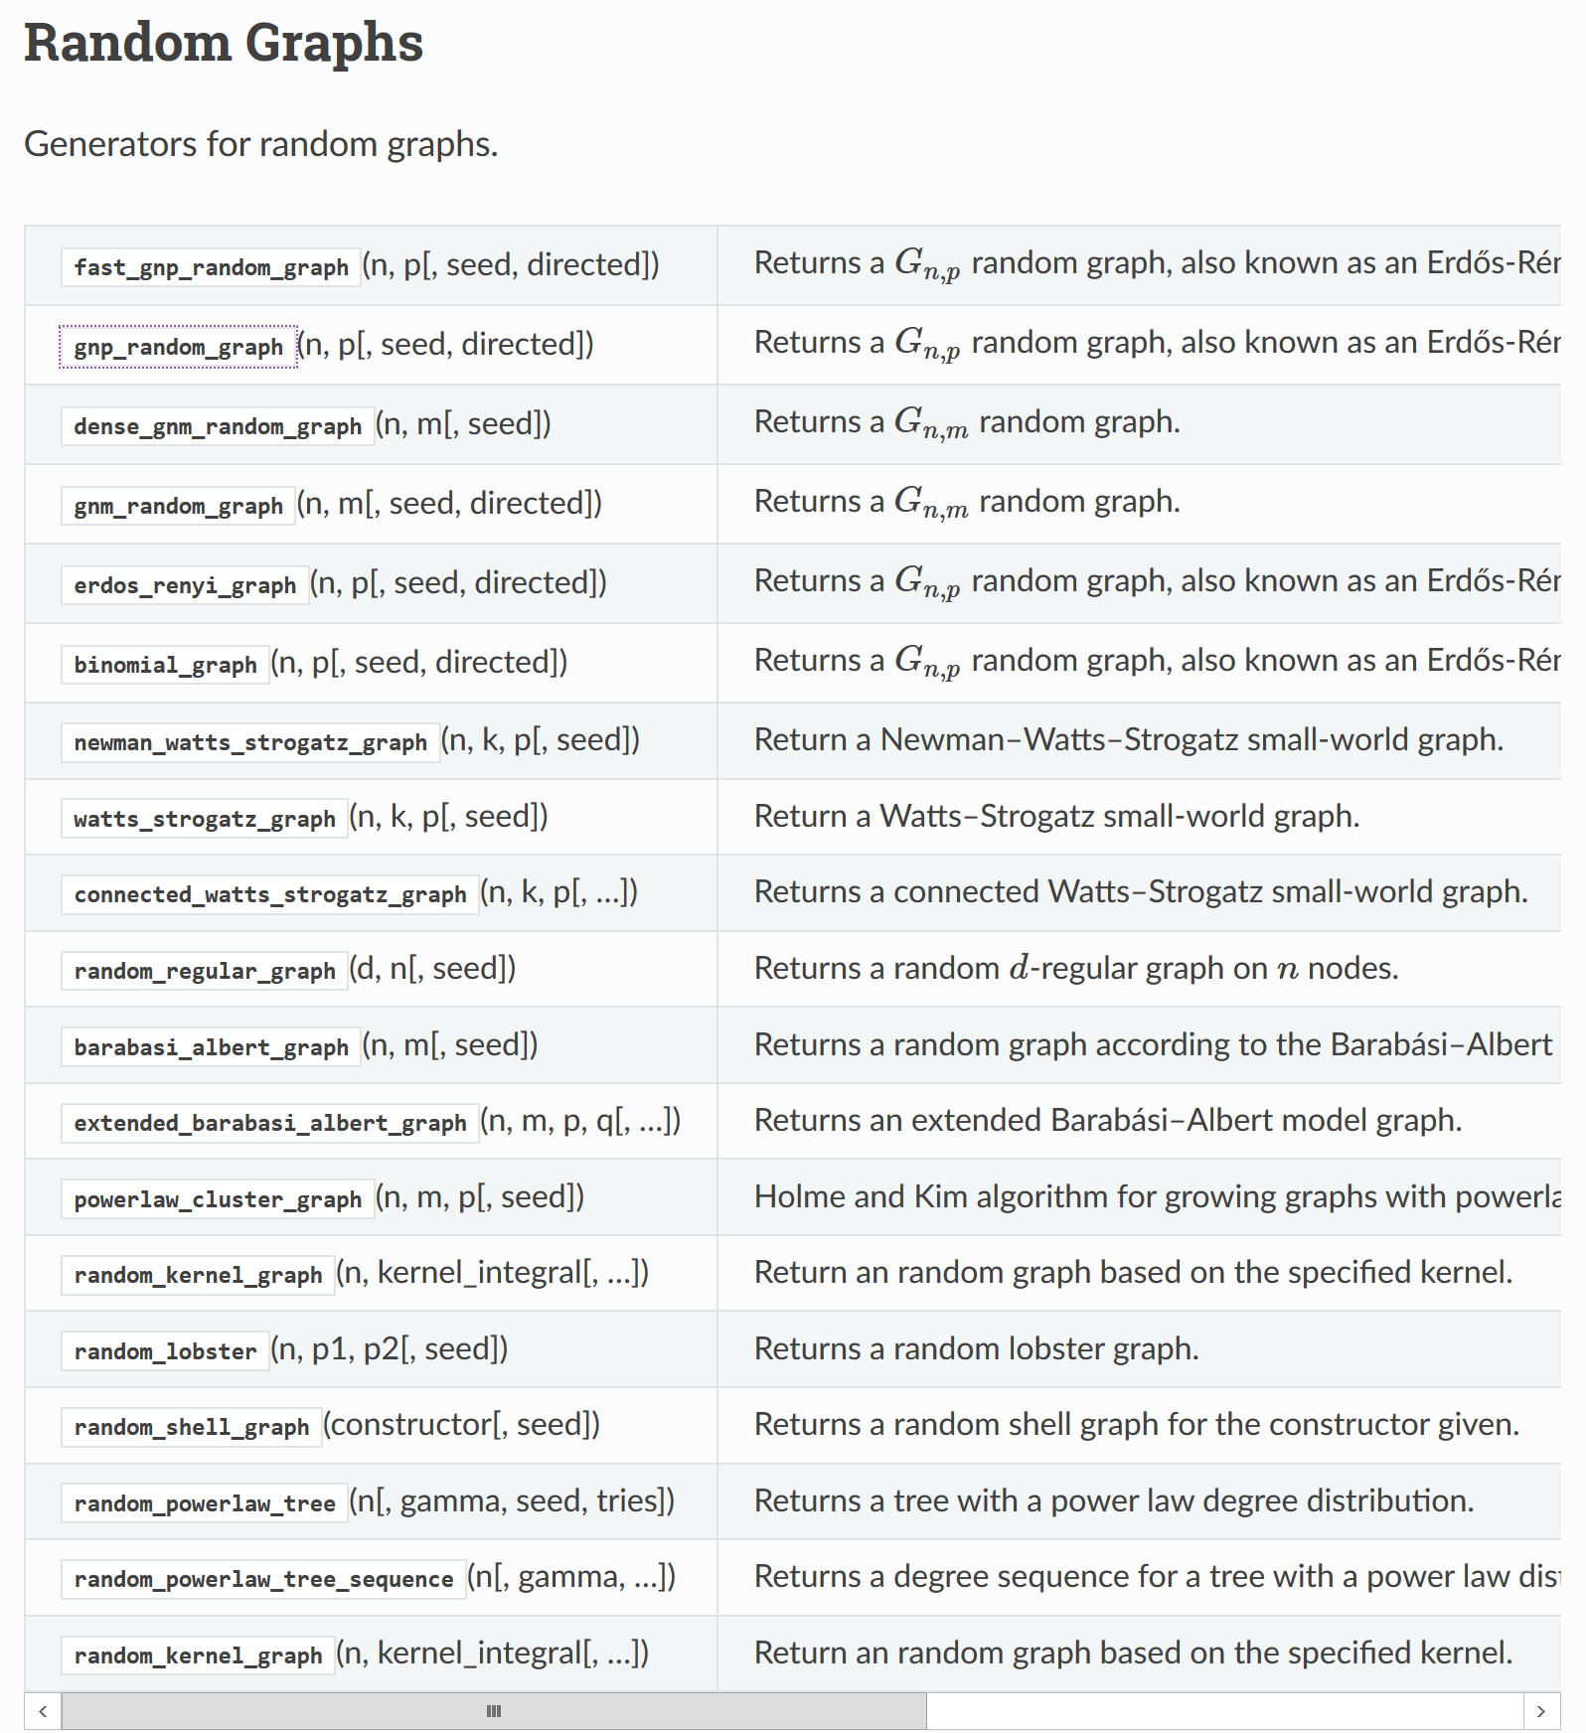

Slide 31
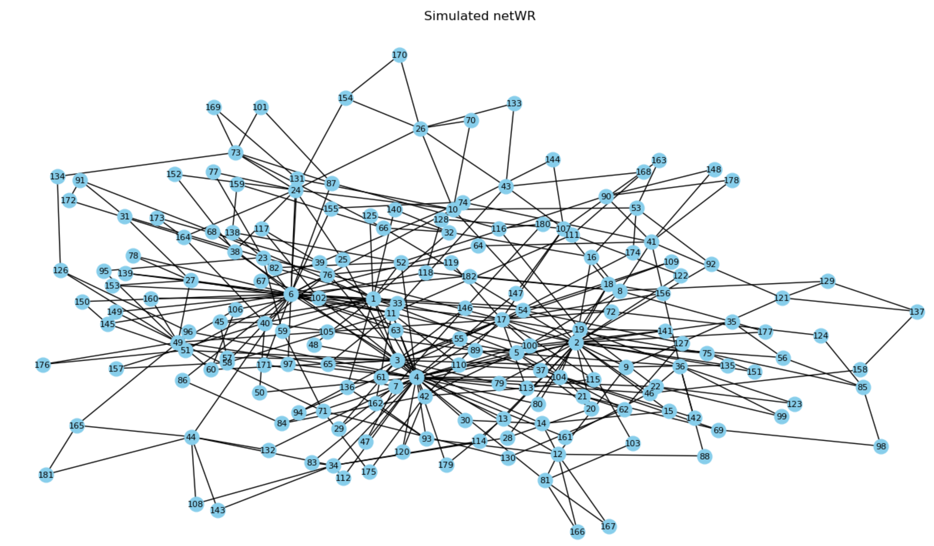
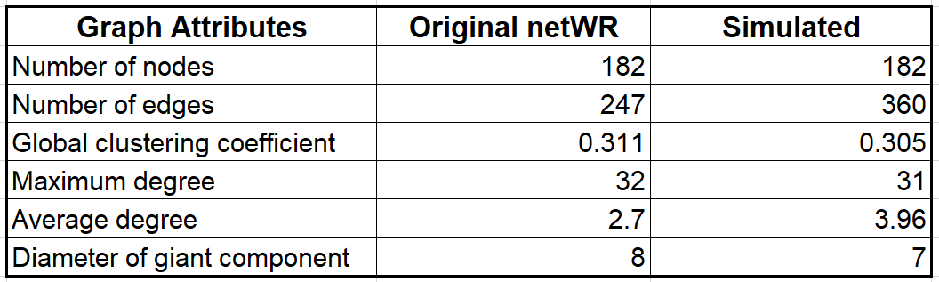
netWR – Original Vs Simulated Graph
Original
rand_net = nx.powerlaw_cluster_graph(182,2,0.38)
G_similarity = nx.algorithms.similarity.graph_edit_distance(rand_net, netWR_G)

Slide 32
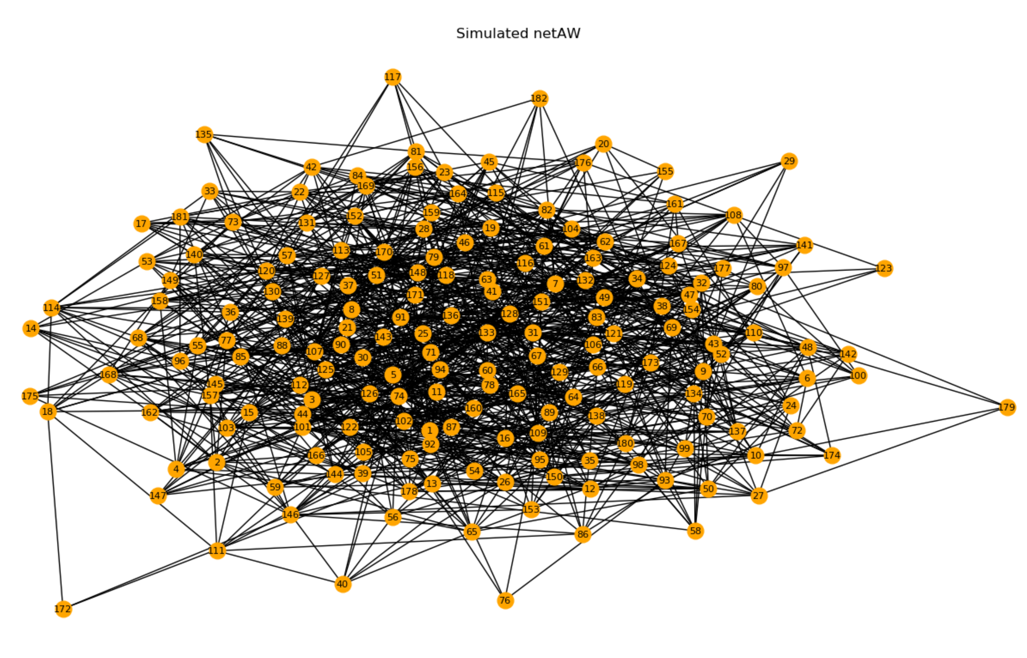
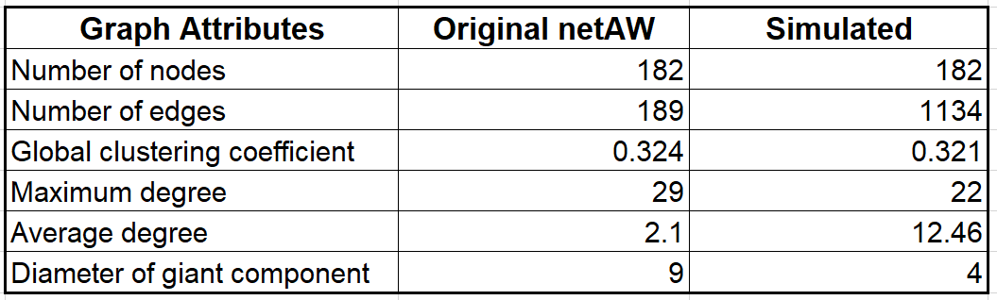
netAW – Original Vs Simulated Graph (cont.)
Original
rand_net = nx.fast_gnp_random_graph(182,0.068)

Slide 33
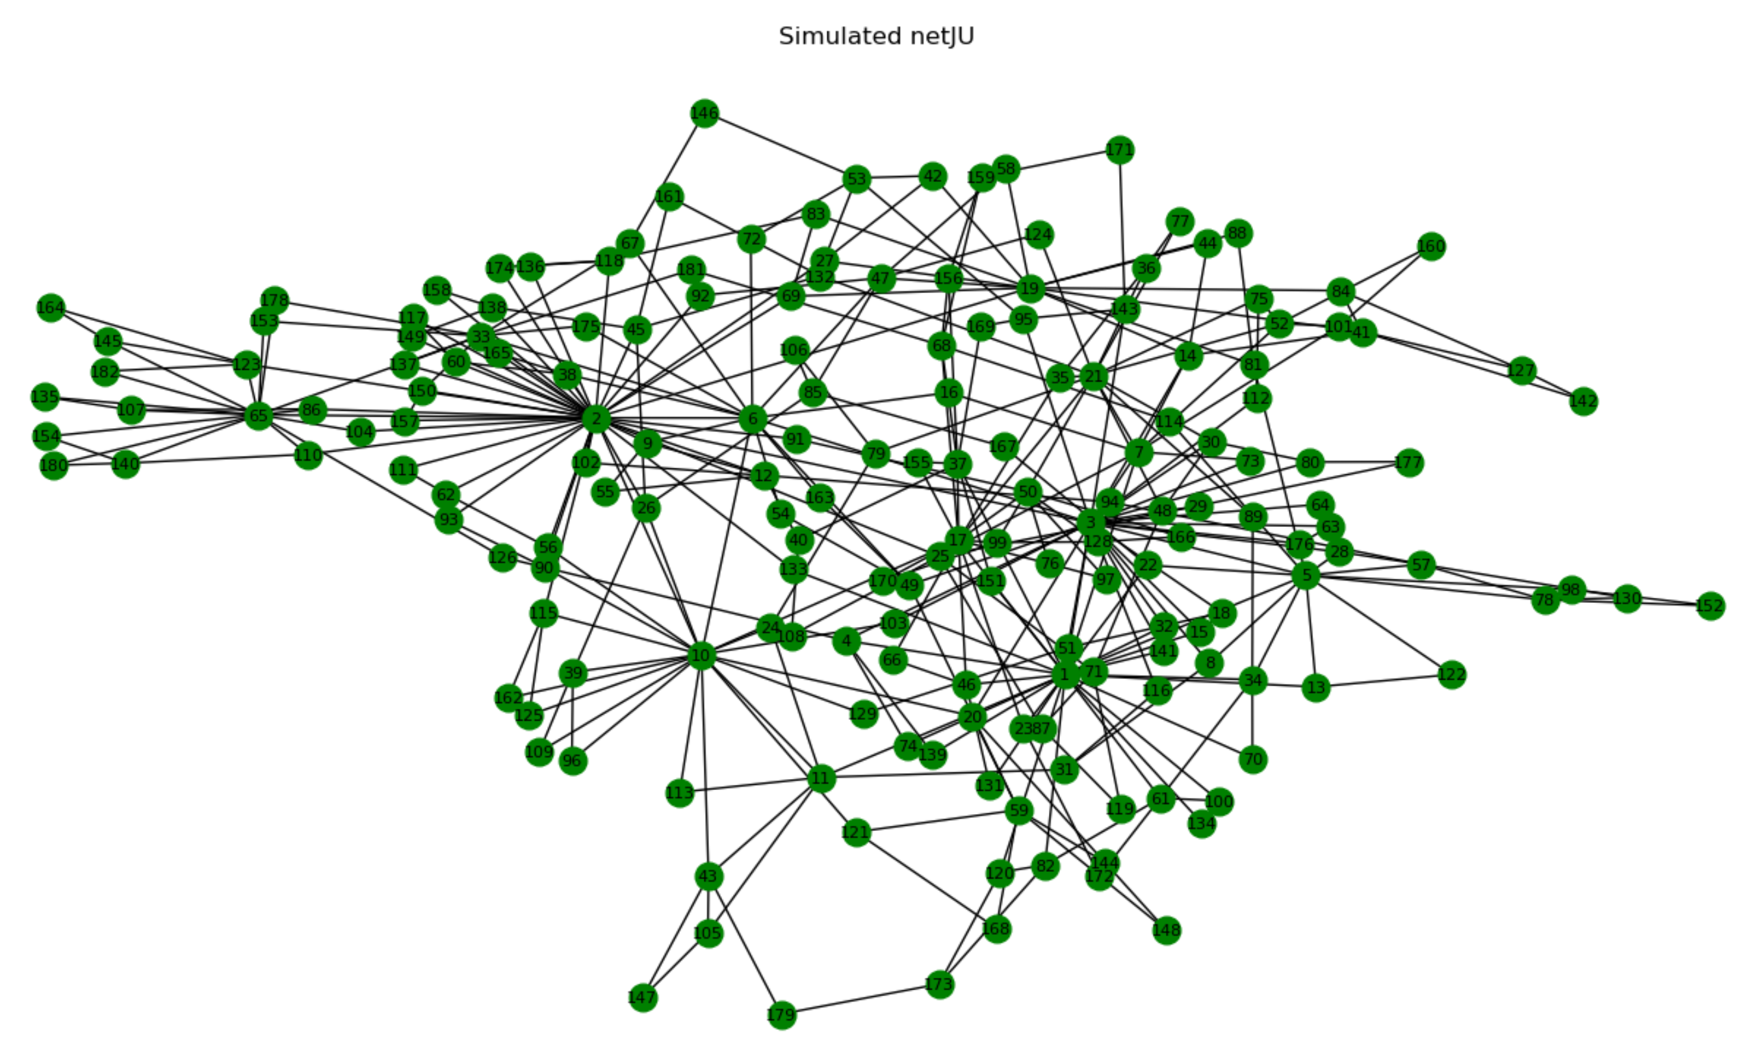
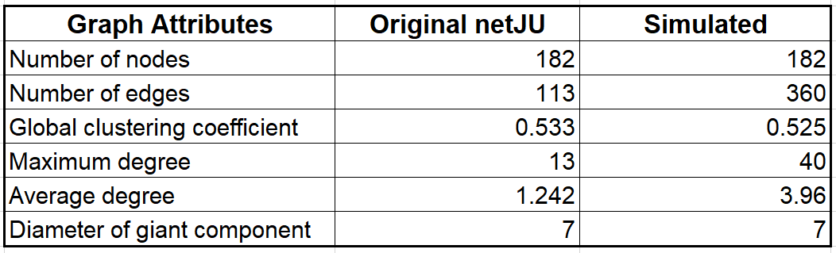
netJU - Original Vs Simulated Graph (cont.)
Original
rand_net = nx.powerlaw_cluster_graph(182,2,0.76)

Slide 34
References
[1] Berlusconi, G., Calderoni, F., Parolini, N., Verani, M., & Piccardi, C. (2016). Link prediction in criminal networks: A tool for criminal intelligence analysis. PloS one, 11(4), e0154244.
[2] Mastrobuoni, G., & Patacchini, E. (2012). Organized crime networks: An application of network analysis techniques to the American mafia. Review of Network Economics, 11(3).

Slide 35

Thanks for your attention!

